Slide 1


Dandelion
Dandelion Capstone Project Presentation 卒業論文プレゼンテーション

Slide 2

About us
Supervisor
指導教員
Team member
チームメンバー
Nguyen Van Sang
Luu Ngoc Manh
Nguyen Minh Huy
Vu Ngoc Trung
Duong Duc Anh
Vu Cong Chinh
Cao Thi Phuong Mai
1

Slide 3


Outlines -アウトライン
1
Introduction
導入
2
Project Management
プロジェクト管理
3
Software Requirement Specification
プロジェクト管理
4
Software Design Description
ソフトウェア要求仕様
5
Quality Control
品質管理
6
Project Result
プロジェクト結果
7
Demo
デモ
8
Q & A
質問と回答

Slide 4
Outlines -アウトライン
1
Introduction
導入
2
Project Management
プロジェクト管理
3
Software Requirement Specification
プロジェクト管理
4
Software Design Description
ソフトウェア要求仕様
5
Quality Control
品質管理
6
Project Result
プロジェクト結果
7
Demo
デモ
8
Q & A
質問と回答
Coming up next
Vu Ngoc Trung
1

Slide 5


1
Introduction
導入
1
Introduction
導入
3

Slide 6

1
Introduction
導入
1. Introduction - 導入
1.1 Current Situation
1.2 The Idea
1.3 Objectives
1.4 Benefit From Project
3

Slide 7
1
Introduction
導入
1.1 Current Situation - 現在状況
A lot of project
Indivial, company - Small, medium
But
Short of funds to raise
Don’t know where to funding
In Vietnam
Need major platform for crowdfunding
Lots of good payment method
4

Slide 8


1
Introduction
導入
1.1 Current Situation - 現在状況
Máy đọc sách cho người khiếm thị
Nước Cốt Thanh Long
4

Slide 9
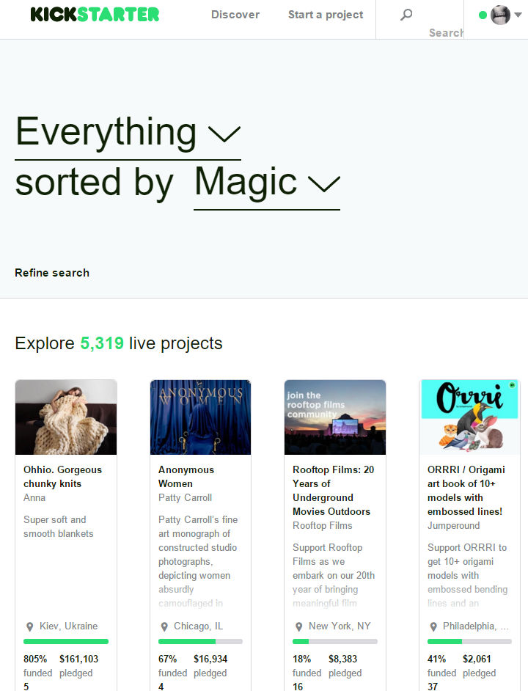
1
Introduction
導入
Kickstater.com
Advantages:
The biggest major platform for crowdfunding
Kickstarter staff provide feedback to help your project succeed.
Disadvantages:
You have to be based in the US, Canada, the UK, Australia, New Zealand or the Netherlands.
Only support PayPal, MasterCard, etc. These are not popular in Vietnam.
6

Slide 10
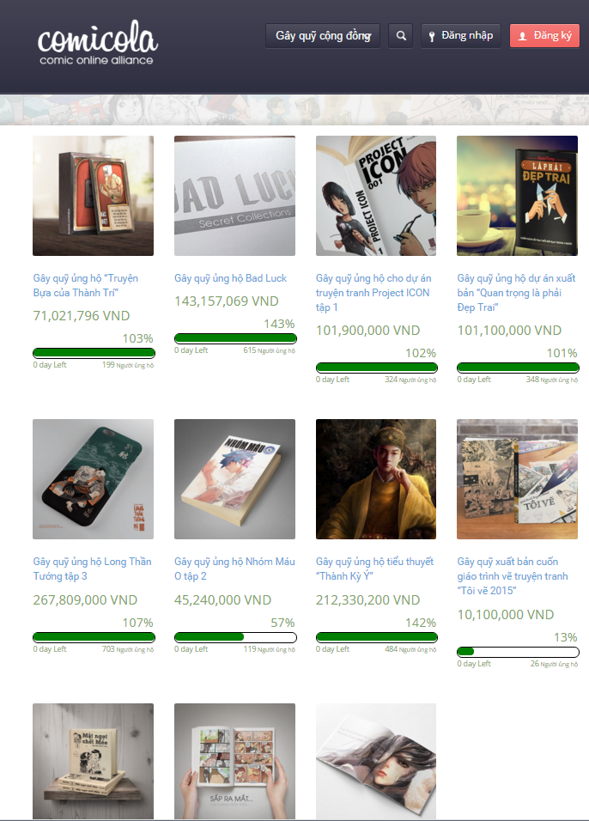
1
Introduction
導入
Comicola.com
Advantages:
Has friendly user interface – Vietnamese.
Making payments easier for creators and backers.
Disadvantages:
Just for comic project.
7

Slide 11
1
Introduction
導入
1.2 The Idea - アイデア
Build a website allow
Crowdfunding to raise project
Backing project to get the products and amazing rewards
5

Slide 12
1
Introduction
導入
1.3 Proposal - 提案
Build a website
Used technology .NET MVC5, AngularJS...
Help people to funding, backing... project
Completely support Vietnamese user.
Improve team member
Development, management, teamwork skill
Technical experience
8
Notes:
Technical experience : website designing, software testing
Support people’s dream : especially Vietnamese users to create something that they want to see exist in the world
Everything : films, games, and music to art, design, and technology

Slide 13
Outlines -アウトライン
1
Introduction
導入
2
Project Management
プロジェクト管理
3
Software Requirement Specification
プロジェクト管理
4
Software Design Description
ソフトウェア要求仕様
5
Quality Control
品質管理
6
Project Result
プロジェクト結果
7
Demo
デモ
8
Q & A
質問と回答
Coming up next
Cao Thi Phuong Mai

Slide 14
2
Project Management
プロジェクト管理
2
Project Management
プロジェクト管理
10

Slide 15
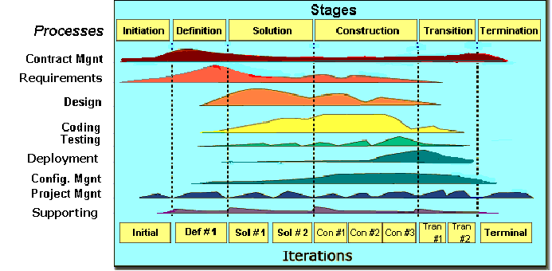

2.1 Software Process Model ソフトウェアプロセスモデル
2
Project Management
プロジェクト管理
FPT Software process model
11

Slide 16
2.1 Software Process Model ソフトウェアプロセスモデル
2
Project Management
プロジェクト管理
Initiation | Identify business functions of the system Determine scope, condition, limitation, project risk List main functions Complete Report #1
Solution | Complete SRS, Architecture Design and Database Design Complete Report #2
Construction | Report #3, Report #4 Complete Coding and Testing
Termination | Complete software packages and Report #5, Report #6 Preparing presentation Complete Project
Project Life Cycle
12

Slide 17
2.2 Project Organization -プロジェクト組織
2
Project Management
プロジェクト管理
Nguyễn Văn Sang
Instructor
Lưu Ngọc Mạnh
Project Manager
Lưu Ngọc Mạnh
Technical Leader
Vũ Ngọc Trung
Developer
Vũ Công Chính
Tester
Nguyễn Minh Huy
Developer
Cao Thị Phương Mai
Test Leader/QA
Dương Đức Anh
Developer
Cao Thị Phương Mai
Developer
Vũ Công Chính
Design Leader
Dương Đức Anh
Designer
13

Slide 18
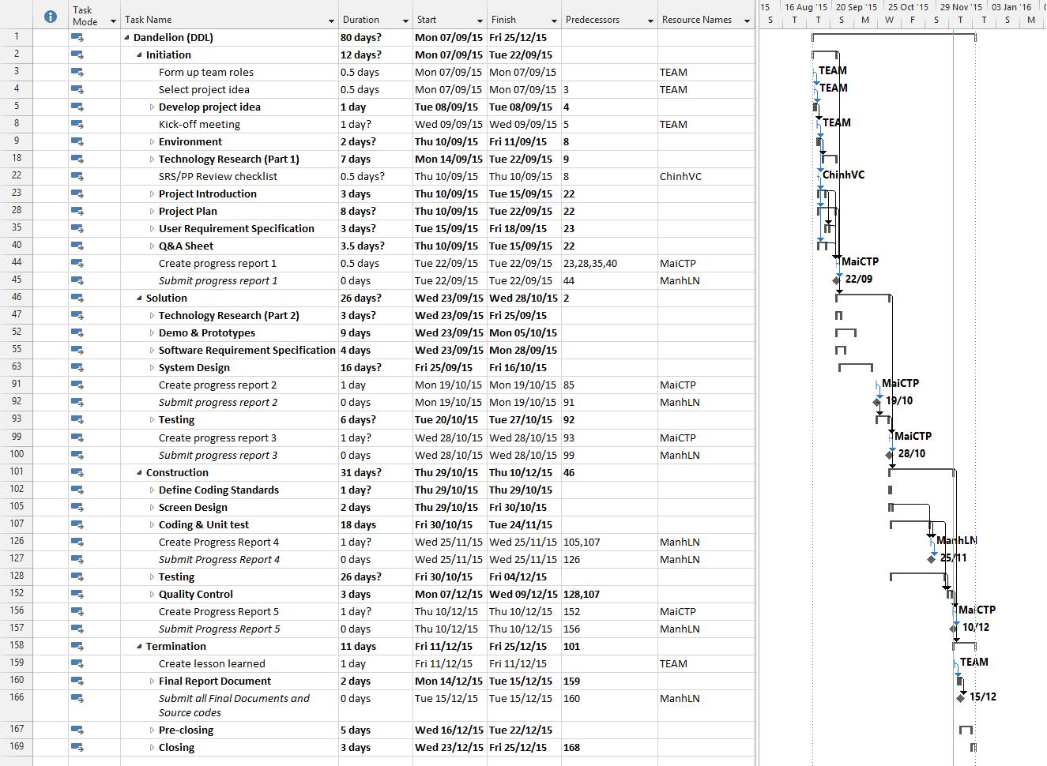
2.3 Project Schedule - プロジェクト計画
2
Project Management
プロジェクト管理
14

Slide 19
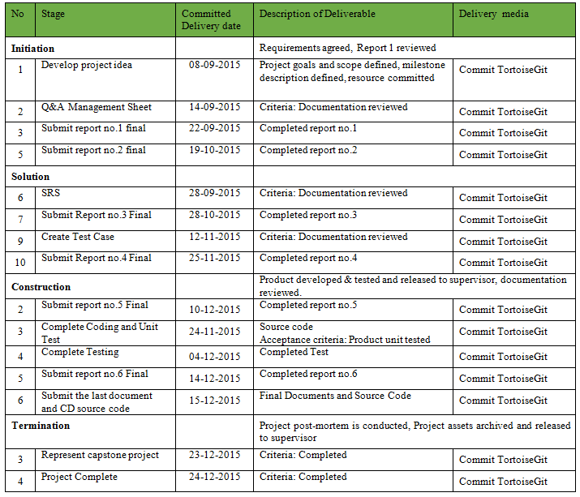
2.4 Objectives & deliverables -目標と成果物
2
Project Management
プロジェクト管理
15

Slide 20










2.5 Tools & Infrastructure ツールと インフラストラクチャ
2
Project Management
プロジェクト管理
Tools
Tools for project management
Tools for developing
TortoiseGit
Word 2013
Excel 2013
Project 2013
Power Point 2013
Visual studio 2013
Chrome
Firefox
Sublime Text
EA
16

Slide 21
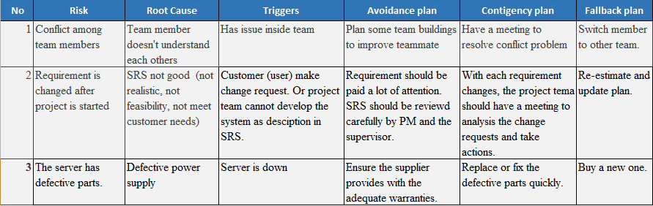
2.6 Risks management -リスク管理
2
Project Management
プロジェクト管理
17

Slide 22
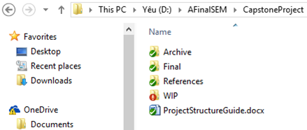
2.7 Configuration management コンフィグレーション管理
2
Project Management
プロジェクト管理
Final: Store sent and delivered documents
References: Store reference documents. For example: templates, technologies document…
WIP: Store documents in progress developing
Plan: Plan of capstone project
Users: Working Folder of Member
Documents: Store whole documents in progress developing
Records: Store documents like Meeting Minutes, Q & A Management…
Folder structure of project
18

Slide 23
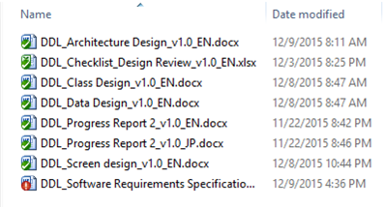
2.7 Configuration management コンフィグレーション管理
2
Project Management
プロジェクト管理
Rule: ProjectCode_Document’s name_v<x.x>_language
ProjectCode: FA{
Document’s name: Architecture Design, Class Design…
v<x.x>: document’s version. For example: v1.0, v1.1,…
Language:
EN: English
JP: Japanese
Naming conventions
19

Slide 24
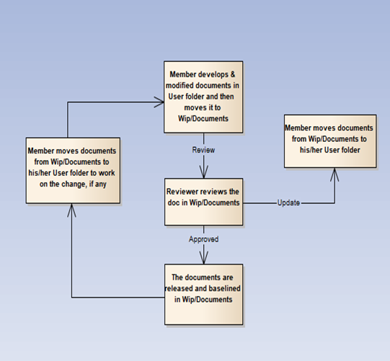
2.7 Configuration management コンフィグレーション管理
2
Project Management
プロジェクト管理
20

Slide 25
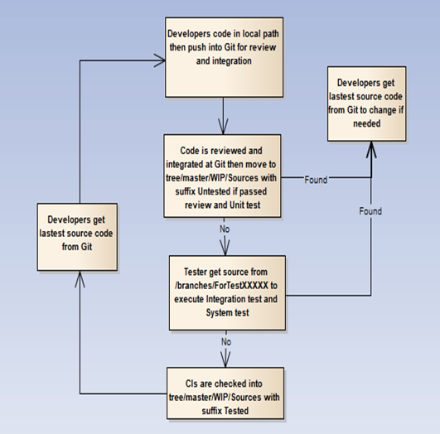
2.7 Configuration management コンフィグレーション管理
2
Project Management
プロジェクト管理
21

Slide 26


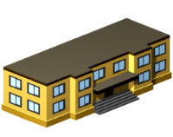






2
Project Management
プロジェクト管理
2.8 Communication management
コミュニケーション管理
Time: 5 hours/day, 5 days/week.
Location: school, home
Communication
Meeting minutes
22

Slide 27
Outlines -アウトライン
1
Introduction
導入
2
Project Management
プロジェクト管理
3
Software Requirement Specification
プロジェクト管理
4
Software Design Description
ソフトウェア要求仕様
5
Quality Control
品質管理
6
Project Result
プロジェクト結果
7
Demo
デモ
8
Q & A
質問と回答
Coming up next
Duong Duc Anh

Slide 28
3
Software Requirement Specification
プロジェクト管理
3
Software Requirement Specification
プロジェクト管理
24

Slide 29


3.1 Business Actors -ビジネスアクター
3
Software Requirement Specification
プロジェクト管理
There are 2 actors:
User
Administrator
25

Slide 30
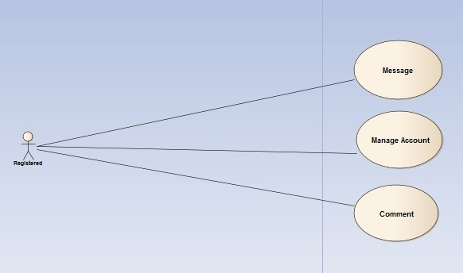
3.2 Functional Requirements - 機能要求
3
Software Requirement Specification
プロジェクト管理
User Module & Account management module
27

Slide 31
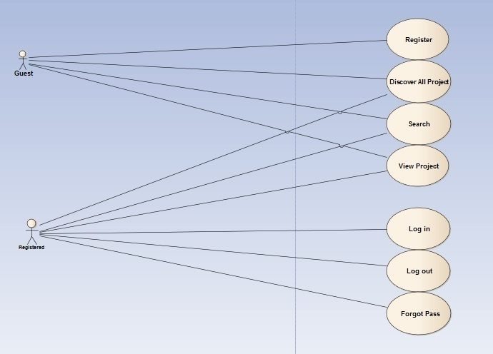
3.2 Functional Requirements - 機能要求
3
Software Requirement Specification
プロジェクト管理
Common module
26

Slide 32
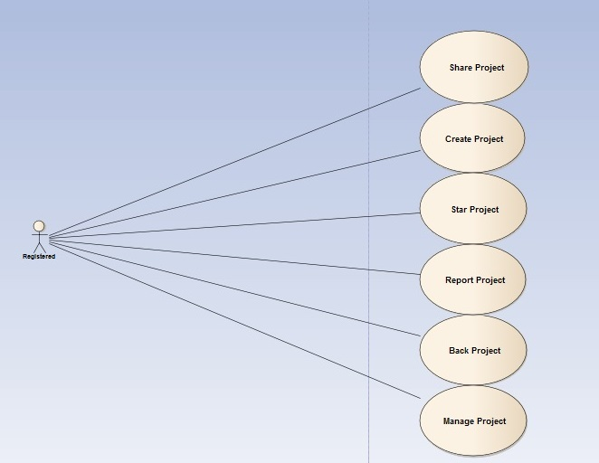
3.2 Functional Requirements - 機能要求
3
Software Requirement Specification
プロジェクト管理
User Module & Project management module
28

Slide 33
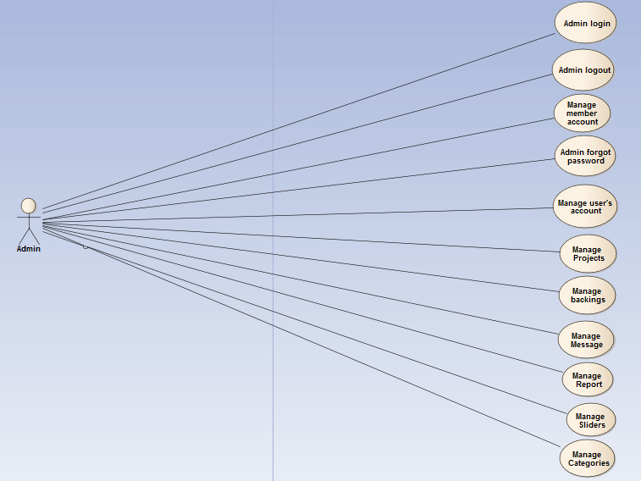
3
Software Requirement Specification
プロジェクト管理
3.2 Functional Requirements - 機能要求
Admin Module
29

Slide 34
3.3 Non-functional Requirements - 非機能要求
3
Software Requirement Specification
プロジェクト管理
Availability
The application must be available 95% of time. Users can access to it everywhere from their Web browser with internet connection.
Performance
In term of response time, waiting time of processing will be 2 to 5 seconds; time to process any functions will not exceed 7 seconds.
Maintainability.
Design
The design of the system must be loosely coupled that chances on some module will not affect others.
Usability
- User can complete each function in less than 12 actions
- Output of the project must include coding standards and naming conventions documentations. Implementation code must be easy to maintain
31

Slide 35
3.3 Non-functional Requirements - 非機能要求
3
Software Requirement Specification
プロジェクト管理
Security Requirements
User authorize
- Each function must be distributed system access and manipulate the individual parts. To edit information, user must declare their username and password before the operation. Functions will be show after users login dependencies user’s role and permission of each user.
Manage Data Layer
- Only Administrator can modify database system
32

Slide 36

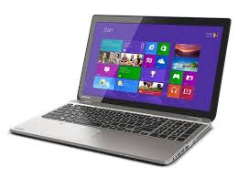

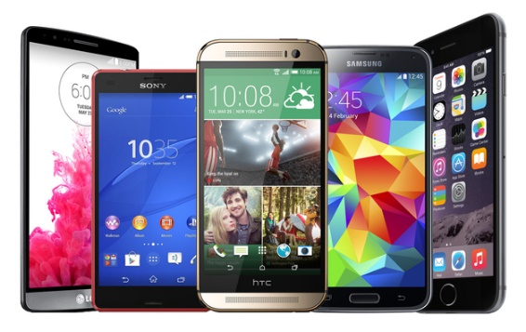
3.3 Non-functional Requirements - 非機能要求
3
Software Requirement Specification
プロジェクト管理
Software Requirements
Chrome
Firefox
Hardware Requirements:
- PC, Laptop , Smartphone with internet connection.
33

Slide 37
Outlines -アウトライン
1
Introduction
導入
2
Project Management
プロジェクト管理
3
Software Requirement Specification
プロジェクト管理
4
Software Design Description
ソフトウェア要求仕様
5
Quality Control
品質管理
6
Project Result
プロジェクト結果
7
Demo
デモ
8
Q & A
質問と回答
Coming up next
Luu Ngoc Manh
Nguyen Minh Huy

Slide 38
4
Software Design Description
ソフトウェア要求仕様
4
Software Design Description
ソフトウェア要求仕様
32

Slide 39
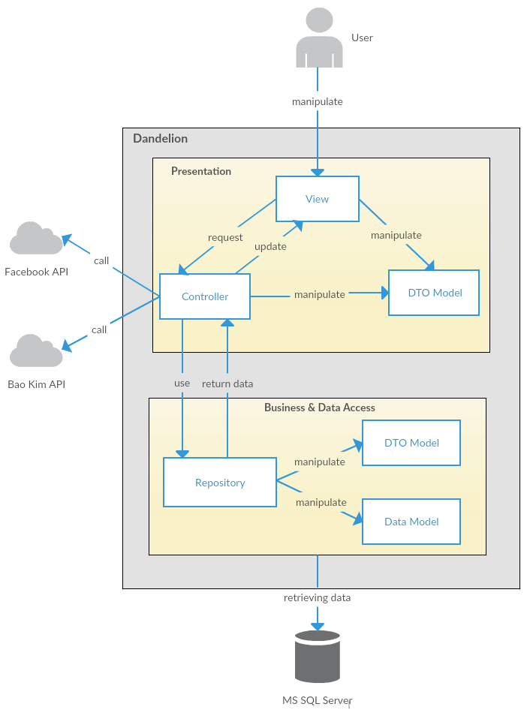
4
Software Design Description
ソフトウェア要求仕様
4.1 Architectural Representation –アーキテクチャ表現
Technology:
ASP.Net MVC
AngularJS
DDL System Overall Architecture
DDL システム全体のアーキテクチャ
32

Slide 40
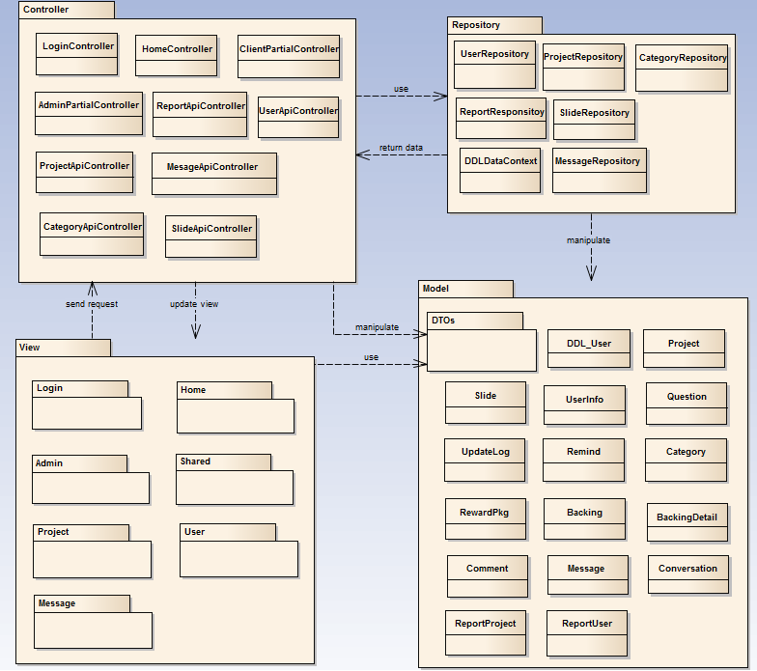

4
Software Design Description
ソフトウェア要求仕様
4.2 Package View - パッケージ ビュ
Package View - パッケージ ビュー
33

Slide 41
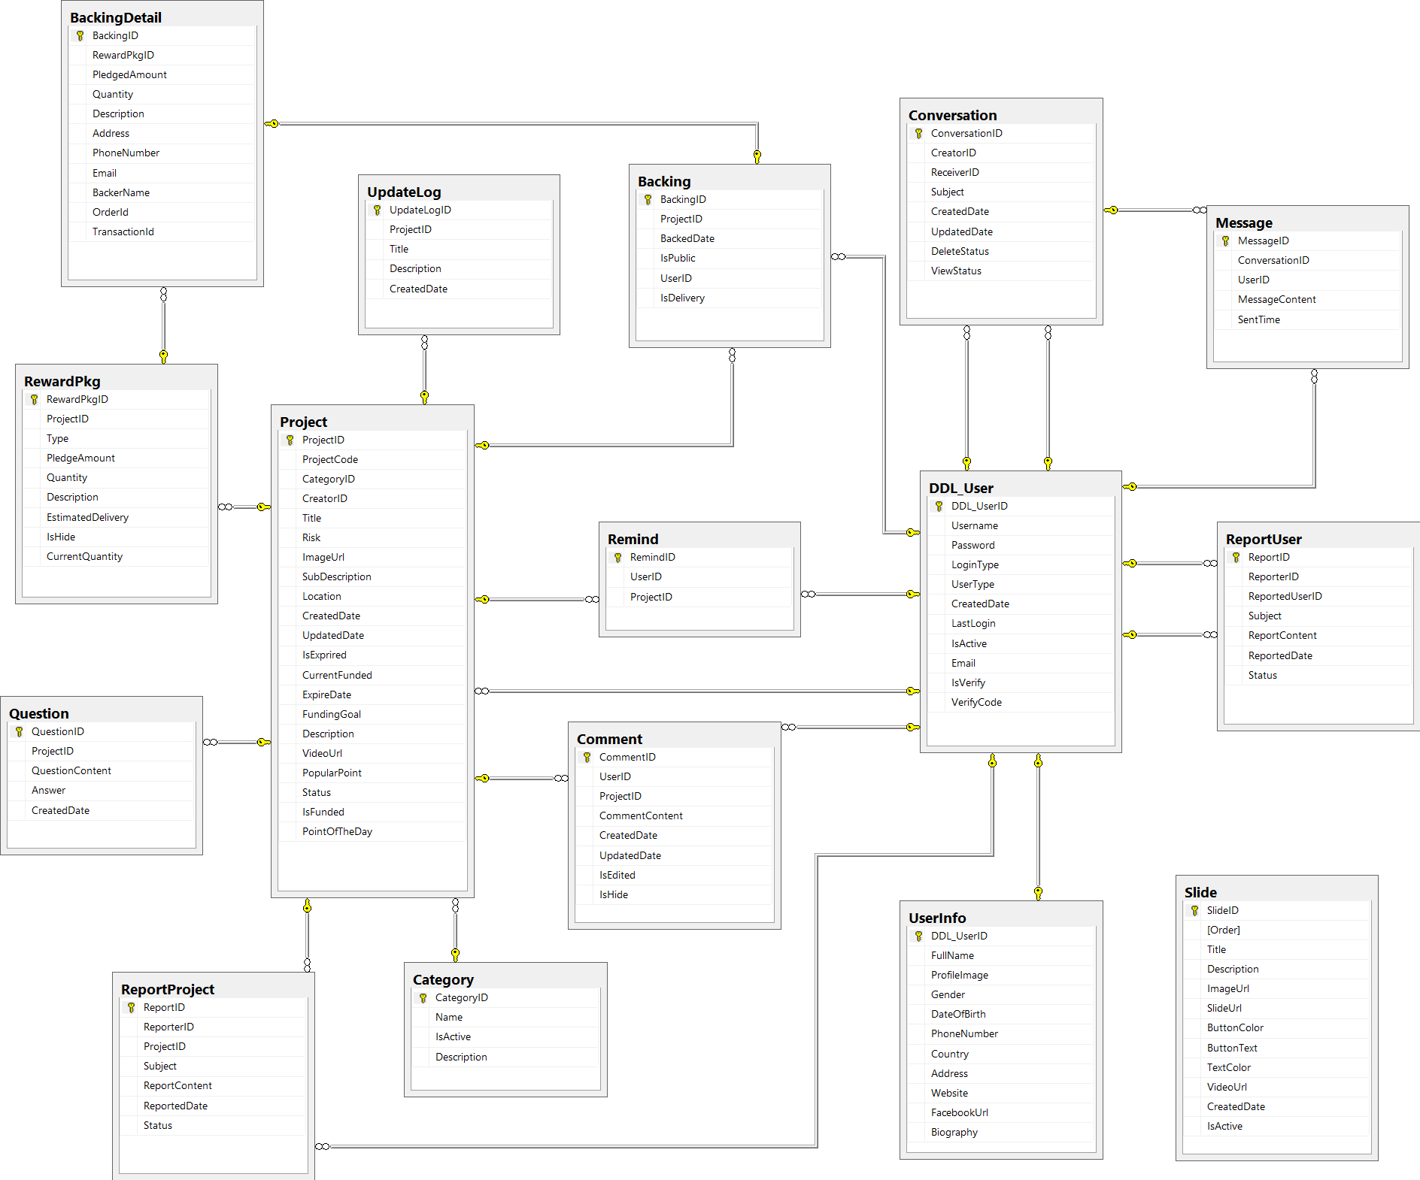
4.3 Database Design -データベース設計
4
Software Design Description
ソフトウェア要求仕様
34

Slide 42
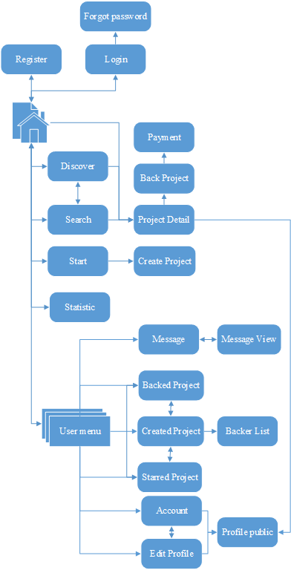
4.4.1 Screen Flow - 画面の流れ
4
Software Design Description
ソフトウェア要求仕様
Main Application screen flow
35

Slide 43
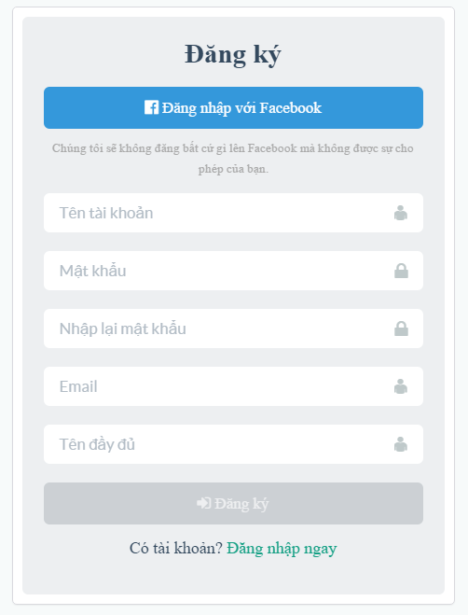
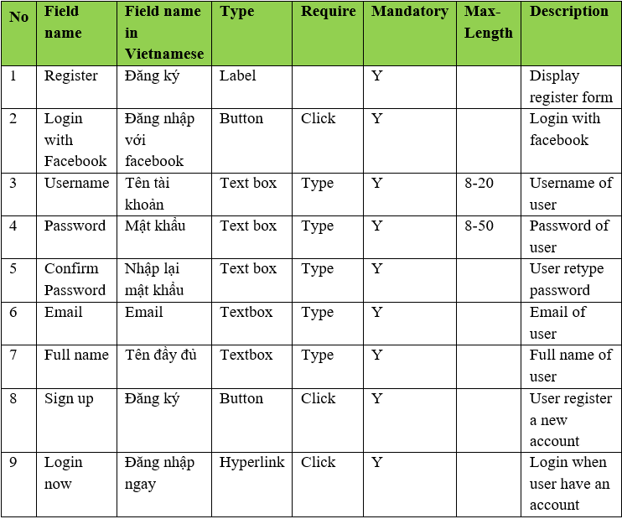
4.4.2 Screen Design - 画面設計
4
Software Design Description
ソフトウェア要求仕様
Register screen design
36

Slide 44
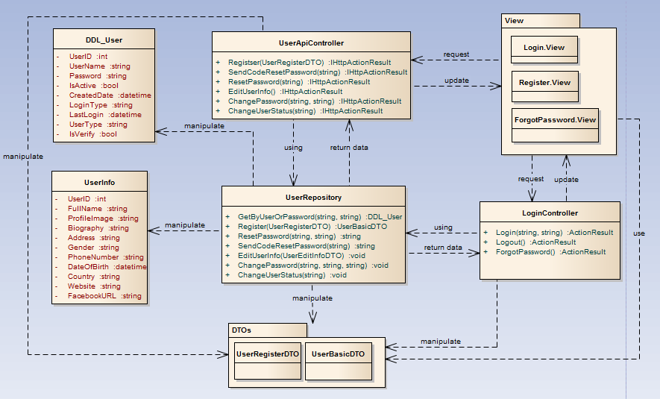
4.5.1 Class Design -クラス設計
4
Software Design Description
ソフトウェア要求仕様
Common functions class diagram
37

Slide 45
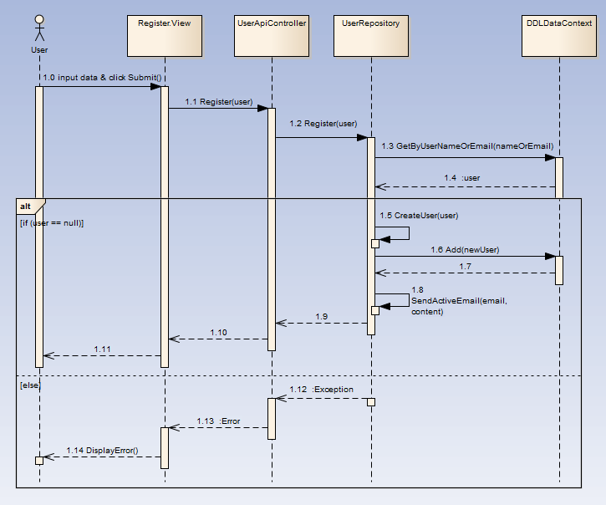
4.5.2 Sequence Diagram -シーケンス図
4
Software Design Description
ソフトウェア要求仕様
Register sequence diagram
38

Slide 46
Outlines -アウトライン
1
Introduction
導入
2
Project Management
プロジェクト管理
3
Software Requirement Specification
プロジェクト管理
4
Software Design Description
ソフトウェア要求仕様
5
Quality Control
品質管理
6
Project Result
プロジェクト結果
7
Demo
デモ
8
Q & A
質問と回答
Coming up next
Vu Cong Chinh

Slide 47
5
Quality Control
品質管理
5
Quality Control
品質管理
40

Slide 48
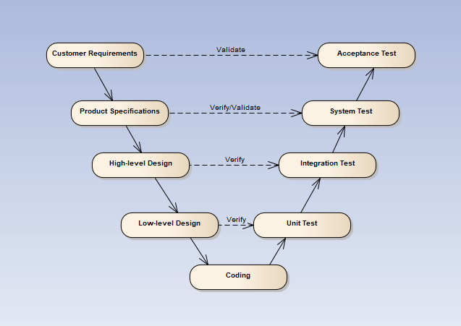
5
Quality Control
品質管理
V-model process
40
Notes:
Testing progress is divided to 5 phases include: Unit test, Component test, Integration test, System test and Acceptance test
Unit test:
Unit testing is used to verify a single minimal unit of source code. The purpose of unit testing is to isolate the smallest testable parts of DDL and verify that they function properly in isolation.
Unit testing is the first level of testing and is perform prior to component testing
Unit testing will be done by developer.
Component test:
Component testing is used to validate a combined many minimal units of source code.
Component testing is performed after unit testing and before integration testing
Component testing will be done by tester
Integration test:
Integration testing is a level of the software testing process where individual units or component are combined and tested as a group.
The purpose is to expose faults in the interaction between integrated units.
Integration testing is performed after component testing
Integration testing will be done by tester

Slide 49
5
Quality Control
品質管理
5.1 Review
5.1.2 SRS
5.1.3 Design
5.1.4 Code
5.2 Testing
5.2.1Test Process
5.2.2Test Report
5.1.5 Test Document
5.1.1 Project Plan
41

Slide 50
5.1 Review
5
Quality Control
品質管理
Self-review
PM review
Peer review
42

Slide 51
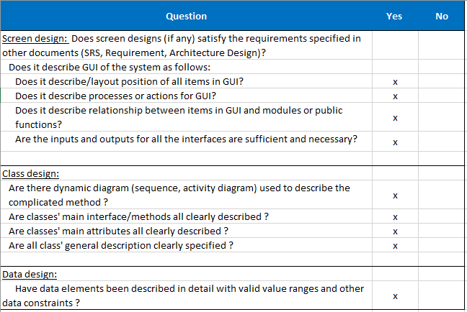
5.1 Review
5
Quality Control
品質管理
Design review
43

Slide 52
5.2.1 Test Process -テストのプロセス
5
Quality Control
品質管理
Base on Project Plan, Project Schedule , SRS to create test plan:
Features to be tested
Acceptance Test Criteria
Environment
Schedules
Responsibilities
Risks and contingencies
…
1
Create Test Plan
2
7
3
4
5
6
Create Test Case
Review Test Case
Execute Test
Log Bug
Re-test
Create Test Report
44

Slide 53
5.2.1 Test Process -テストのプロセス
5
Quality Control
品質管理
Acceptance test criteria:
Statement coverage: 100%
Branch coverage: 100%
Path coverage: 100%
Test Approach:
Unit Test: Developer
Integration Test: Tester
System Test: Tester
Acceptance Test: Customer
Test Environment:
Web :Chrome 40 or above
Firefox 30 or above
1
Create Test Plan
2
7
3
4
5
6
Create Test Case
Review Test Case
Execute Test
Log Bug
Re-test
Create Test Report
45

Slide 54
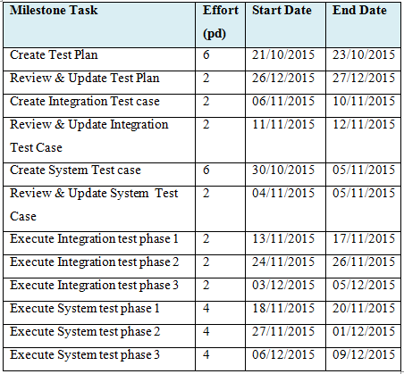
5.2.1 Test Process -テストのプロセス
5
Quality Control
品質管理
1
Create Test Plan
2
7
3
4
5
6
Create Test Case
Review Test Case
Execute Test
Log Bug
Re-test
Create Test Report
46

Slide 55
5.2 Test Process -テストのプロセス
5
Quality Control
品質管理
Base on SRS, create test case:
Unit test case
Integration test case
System test case
Acceptance test case
1
Create Test Plan
2
7
3
4
5
6
Create Test Case
Review Test Case
Execute Test
Log Bug
Re-test
Create Test Report
47

Slide 56
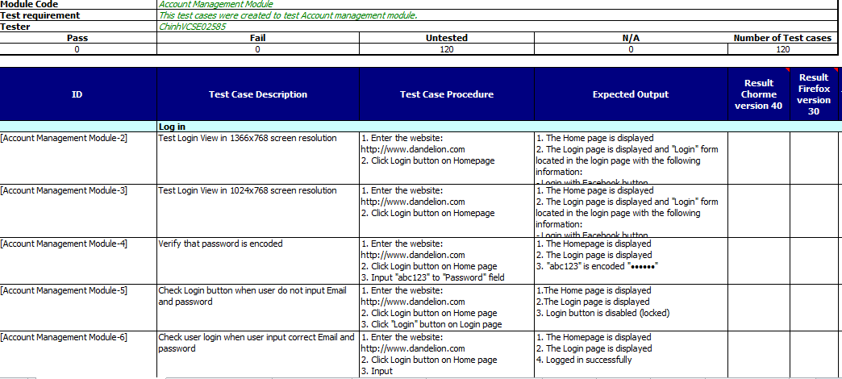
System test case -システムテストケース
5
Quality Control
品質管理
48

Slide 57
5.2 Test Process -テストのプロセス
5
Quality Control
品質管理
Developer self-review:
Unit test case
Tester self-review and peer-review:
Integration test case
System test case
1
Create Test Plan
2
7
3
4
5
6
Create Test Case
Review Test Case
Execute Test
Log Bug
Re-test
Create Test Report
49

Slide 58
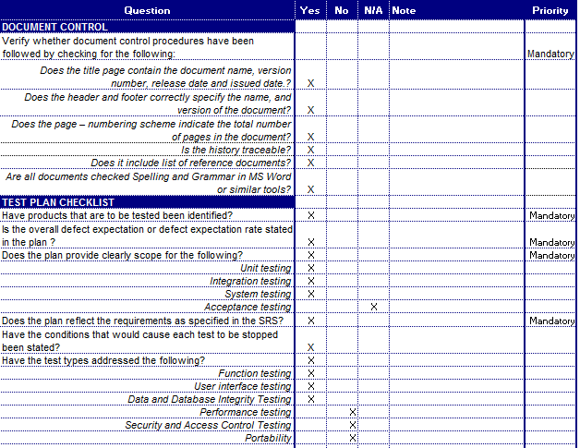
Test case review checklist -テストレビュー
5
Quality Control
品質管理
50

Slide 59
5.2 Test Process -テストのプロセス
5
Quality Control
品質管理
Tester execute test case follow phase:
Unit testing
Integration testing
System testing
1
Create Test Plan
2
7
3
4
5
6
Create Test Case
Review Test Case
Execute Test
Log Bug
Re-test
Create Test Report
51

Slide 60
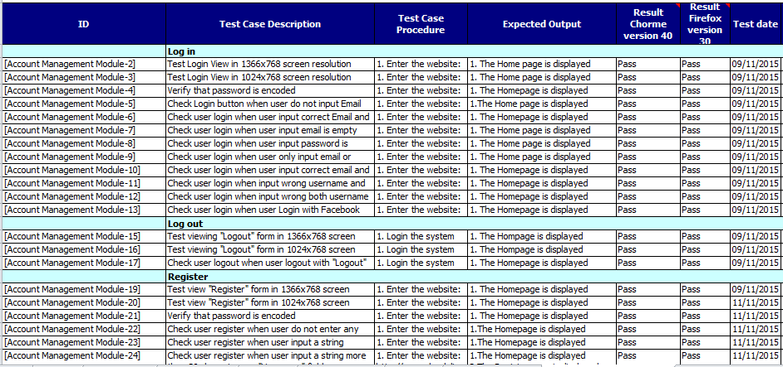
Execute test case -テストケースの実行
5
Quality Control
品質管理
System test result
52

Slide 61
5.2 Test Process -テストのプロセス
5
Quality Control
品質管理
While executing test, tester detect, log bug and assign to appropriate developer.
1
Create Test Plan
2
7
3
4
5
6
Create Test Case
Review Test Case
Execute Test
Log Bug
Re-test
Create Test Report
53

Slide 62
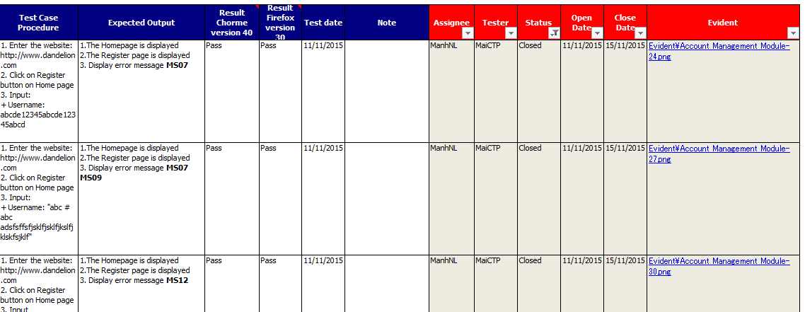
Log bug
5
Quality Control
品質管理
54

Slide 63
5.2 Test Process -テストのプロセス
5
Quality Control
品質管理
When Developer fixed bug, Tester re-test until bug was fixed successfully, then change defect of status to Closed.
1
Create Test Plan
2
7
3
4
5
6
Create Test Case
Review Test Case
Execute Test
Log Bug
Re-test
Create Test Report
55

Slide 64
5.2 Test Process -テストのプロセス
5
Quality Control
品質管理
Tester has responsibility to write test report for each test phase. Finish testing phase, Test leader create Test report
1
Create Test Plan
2
7
3
4
5
6
Create Test Case
Review Test Case
Execute Test
Log Bug
Re-test
Create Test Report
56

Slide 65
5.2.2 Test Report -テストのレポート
5
Quality Control
品質管理
Defects | Logged | %Closed | %Invalid | %Open
Critical | 0 | 0% | 0% | 0%
High | 4 | 0% | 0% | 0%
Medium | 24 | 100% | 0% | 0%
Low | 38 | 100% | 0% | 0%
Total | 66 | 100% | 0% | 0%
Defect Report
57

Slide 66
5.2.2 Test Report -テストのレポート
5
Quality Control
品質管理
Phase | Stage 1 |  | Stage 2 |  | Stage 3 |  | Final
 | Pass | Fail | Pass | Fail | Pass | Fail
Unit Test | 356 | 0 | 356 | 0 | 356 | 0 | 356
Integration Test | 298 | 2 | 300 | 0 | 300 | 0 | 300
System Test | 692 | 110 | 714 | 98 | 812 | 0 | 812
Total | 1346 | 112 | 1370 | 98 | 1468 | 0 | 1468
58

Slide 67
Outlines -アウトライン
1
Introduction
導入
2
Project Management
プロジェクト管理
3
Software Requirement Specification
プロジェクト管理
4
Software Design Description
ソフトウェア要求仕様
5
Quality Control
品質管理
6
Project Result
プロジェクト結果
7
Demo
デモ
8
Q & A
質問と回答
Coming up next
Vu Cong Chinh

Slide 68
6
Project Result
プロジェクト結果
6
Project Result
プロジェクト結果
60

Slide 69
6
Project Result
プロジェクト結果
Project summary
Main objective | Develop a system which will provide to users functionality to collect funding for their project and back to get the amazing products from creative projects.
Purpose | Provide a Dandelion online on website.
Source repository | https://github.com/sangnvus/2015FALLJS01.git
 | Plan | Actual
Start date | 07/09/2015 | 07/09/2015
End date | 25/12/2015 | 23/12/2015
Release versions | 1.0 | 1.0
Duration | 80 days | 78 days
Efforts (person day) | 480 | 468
Test cases | 1800 | 1468
Defects | 200-300 | 66
Document pages | ~ 3000 pages | ~ 3500 pages
Lines of code (C#) | ~ 10000 | ~ 15000
Lines of code (HTML) | ~ 5000 | ~ 10000
Lines of code (AngularJS) | ~ 10000 | ~ 13000
LOC (Total) | ~ 25000 | ~ 38000
60

Slide 70
6
Project Result
プロジェクト結果
Project summary
Knowledge:
Work process of FPT Software to develop a project.
Putting the learned knowledge into practice.
Improve skils: teamwork, leader-ship, research and self-study, plan and manage time.
Technical: AngularJS (Single Page Appliction), Azure Web App, WebApi 2.0, ASP.Net MVC5.
Tools: Visual Studio, TortoiseGit, Enterprise Architect, Office tools.
61

Slide 71
Limitation & Expectation -制限と期待
6
Project Result
プロジェクト結果
Current Limitations | Expectation in Future
Some screen can’t display well on Mobile or screen which has resolution lower than 1024x768. Website not support for English language. Not support payment methods for people in other contries. Not support payment by mobile cards. | Support multi-language and other payment method such as visa and master card to get funding from people in other countries. Support payment by mobile cards such as Viettel, Mobi, Vina, … App for Android and IOS which supports members manage their projects and admin can manage system anywhere by smart phone. Expand server to inscrease number of users.
62

Slide 72
Lessons Learnt -学んだ教訓
6
Project Result
プロジェクト結果
Working in group and working individual.
Putting knowledge into practice.
Manage time and make the plan.
Be open to get the better opinions from other member.
Limit and resolve conflicts between members.
63

Slide 73
Outlines -アウトライン
1
Introduction
導入
2
Project Management
プロジェクト管理
3
Software Requirement Specification
プロジェクト管理
4
Software Design Description
ソフトウェア要求仕様
5
Quality Control
品質管理
6
Project Result
プロジェクト結果
7
Demo
デモ
8
Q & A
質問と回答

Slide 74
7
Demo
デモ
7
Demo
デモ
64

Slide 75
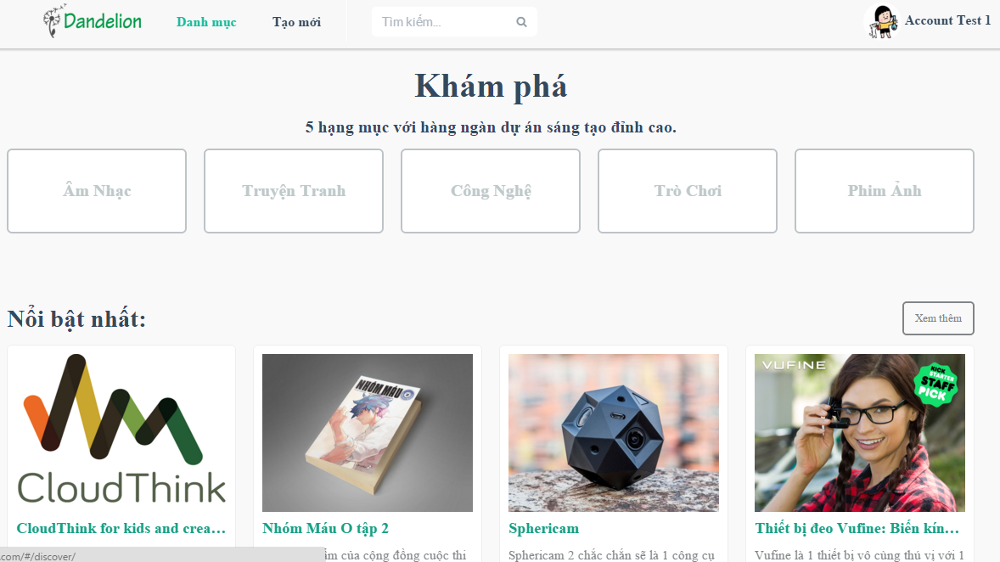
Demo -デモ
7
Demo
デモ
64

Slide 76
Outlines -アウトライン
1
Introduction
導入
2
Project Management
プロジェクト管理
3
Software Requirement Specification
プロジェクト管理
4
Software Design Description
ソフトウェア要求仕様
5
Quality Control
品質管理
6
Project Result
プロジェクト結果
7
Demo
デモ
8
Q & A
質問と回答

Slide 77
8
Q & A
質問と回答
8
Q & A
質問と回答
65

Slide 78
Q & A -質問と回答
8
Q & A
質問と回答
65

